Slide 1

DevOps
The first way

Slide 2
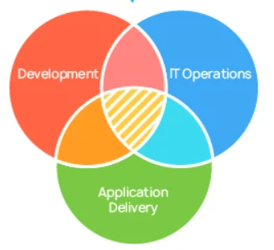
What is DevOps
DevOps is a set of practices and tools which enables teams to deliver high value to end users.
Value is only delivered when users and customers can reliably use the platforms or products to complete their objectives.
DevOps combines the necessary tools, skillsets and disciplines to make this possible.

Slide 3
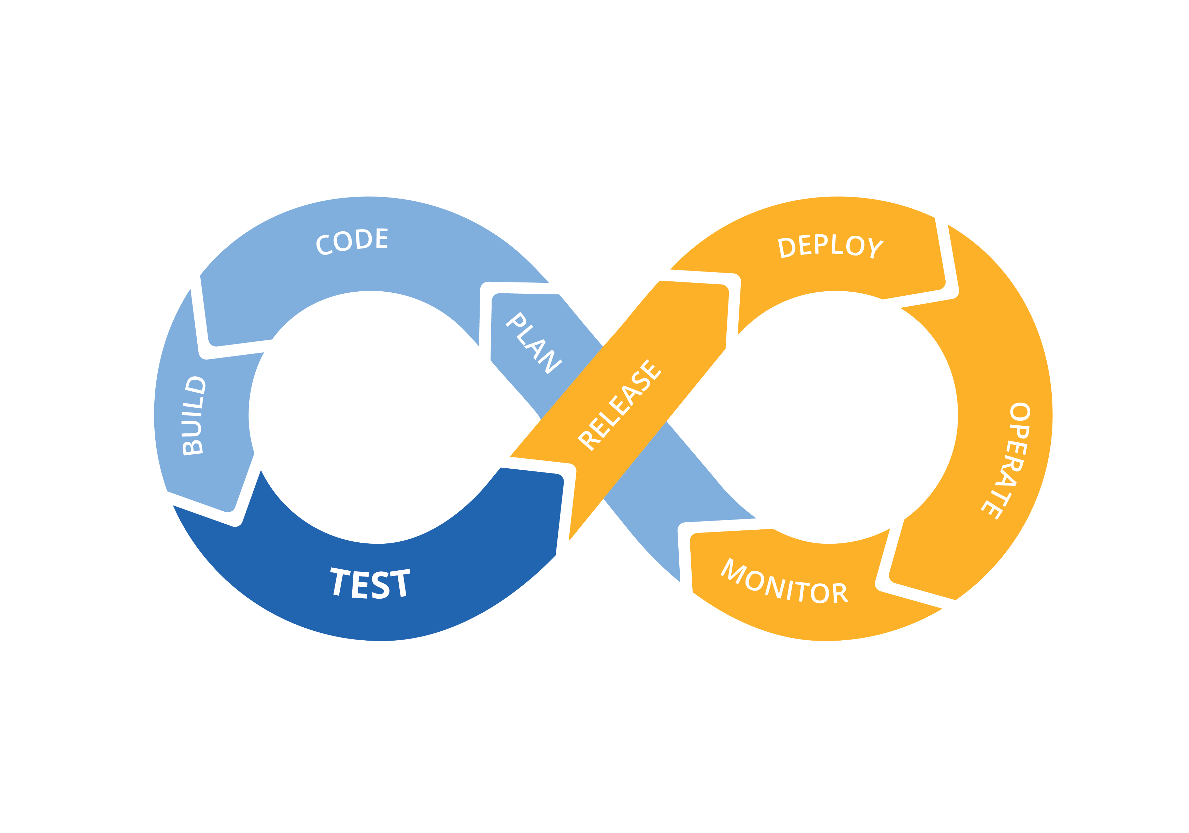
Stages of Adopting DevOps
DevOps Identifies three 'ways' or principles for an organisation to move to:
  Flow: How to move from development to production
  Feedback: How to improve processes
  Learning: Continuous learning and innovation

Slide 4

First Way - Flow
The first stage of putting DevOps processes into an organisation is Flow.
As we saw previously, regular releases has significant advantages
  Less change in each release lowers the risk of each release
  Value is delivered to customers at the earliest possible opportunity.
  Regular repetition of the release process improves performance

Slide 5

Flow
The challenge of regular releases is:
  Releases require regression testing, and manual testing takes a long time
  Manual release processes can be complex, introducing a lot of risk of human error
  Large systems may need releasing in multiple locations
  Any change introduces risk
  Need to be able to 'roll back' changes, which can be complex

Slide 6

Flow
The process through which software flows through any development process is:
Development
Testing
Deployment
DevOps addresses the challenge of regular release through automation.
Test and deployment tools
Scripted processes
Pipeline tools

Slide 7
Flow – Development
Any non-trivial system will be made up of many different parts.
Non-trivial system will have multiple developers, all working on parts of a release.
Each developer should test what they have written (unit testing).
Developers may also be working on different releases so it is necessary to keep a track of what code is meant for which release.
Source Control tools are used to manage this process.

Slide 8
Flow - Integration
When developers are happy their code works it can be combined or 'integrated' with other developer's work
It is necessary to integrate all the new code for a release before the system can be tested.
The integrated code also needs to be built in an environment separate from development, so any changes being developed do not impact the testing.
To get the fastest feedback on testing, the committed code should be integrated and tested as soon as possible.
DevOps uses Continuous Integration tools automate building the code into a test environment.

Slide 9
Flow - Testing
Key to producing high velocity delivery is the automation of testing.
A range of automated testing tools exist which can run scripts to test front and back end functionality, for instance Selenium.
These tools can be integrated into the DevOps pipeline.
As a result test runs can be scheduled as soon as the code has been integrated.

Slide 10
Deployment
Once code has passed all the system and regression testing is complete the software should be ready to release.
The approved release can then be deployed into a production environment.
Tools exist to automate the proess of pushing software releases out, for instance Ansible.
Tools also exist to provision changes to networks and systems along with software, for instance Terraform.
An automated process can be repeated reliably in all the environments that need to be deployed to.

Slide 11
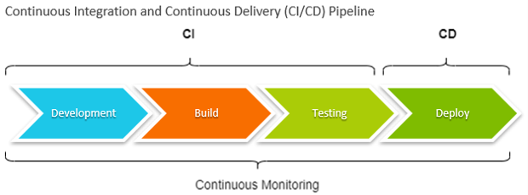
Pipeline Tools
The classic DevOps pipeline uses a set of tools to achieve:
  Continuous Integration (CI)
  Continuous Deployment (CD)
CI/CD tools allow devops teams to script and schedule the whole build, test and deploy process.
There are a number of standalone pipeline tools, the most popular is called Jenkins.
However, tools which are integrated into Source Control tools are becoming increasingly popular –such as Gitlab.

Slide 12
Pipeline – Source Control
The first stage of the CI/CD pipeline is Source Control.
A Source Control System helps keeps track of:
  All source code files
  The version of each file
  The changes between each version
  The release the version of the file is intended for
  Who has worked on each file

Slide 13

The DevOps Pipeline
The purpose of the DevOps Pipeline is to automate all parts of the application delivery process.
IT departments can setup a pipeline that is regularly triggered to build, test and even deploy the application automatically.
This automation allows developers to deliver code at very high velocity.

Slide 14

Gitlab Pipeline
Gitlab provides a fully integrated pipeline.
The pipeline is a 'script' which is executed when:
  Code is pushed into Gitlab
  Code is merged in Gitlab (using Merge Requests).

Slide 15

Gitlab Pipeline - Stages
A pipeline is split into a number of stages.
Typical Stages include:
  Building the application (if required).
  Automated testing:
    Unit Testing
    Interface/module testing
    System testing
    Integration testing
  Automated code quality review (e.g. Lint)
  Automated Deployment to production.

Slide 16
Build and Test Environment
In order for Gitlab to build and test an application it needs an environment.
Gitlab needs to be able to control the environment so it can run the pipeline steps.
To do this three steps need to be performed:
  Create an environment for build and test (e.g. XOA VM)
  Install a Gitlab utility called 'Gitlab Runner'.
  Register the Runner with a Gitlab Project.

Slide 17
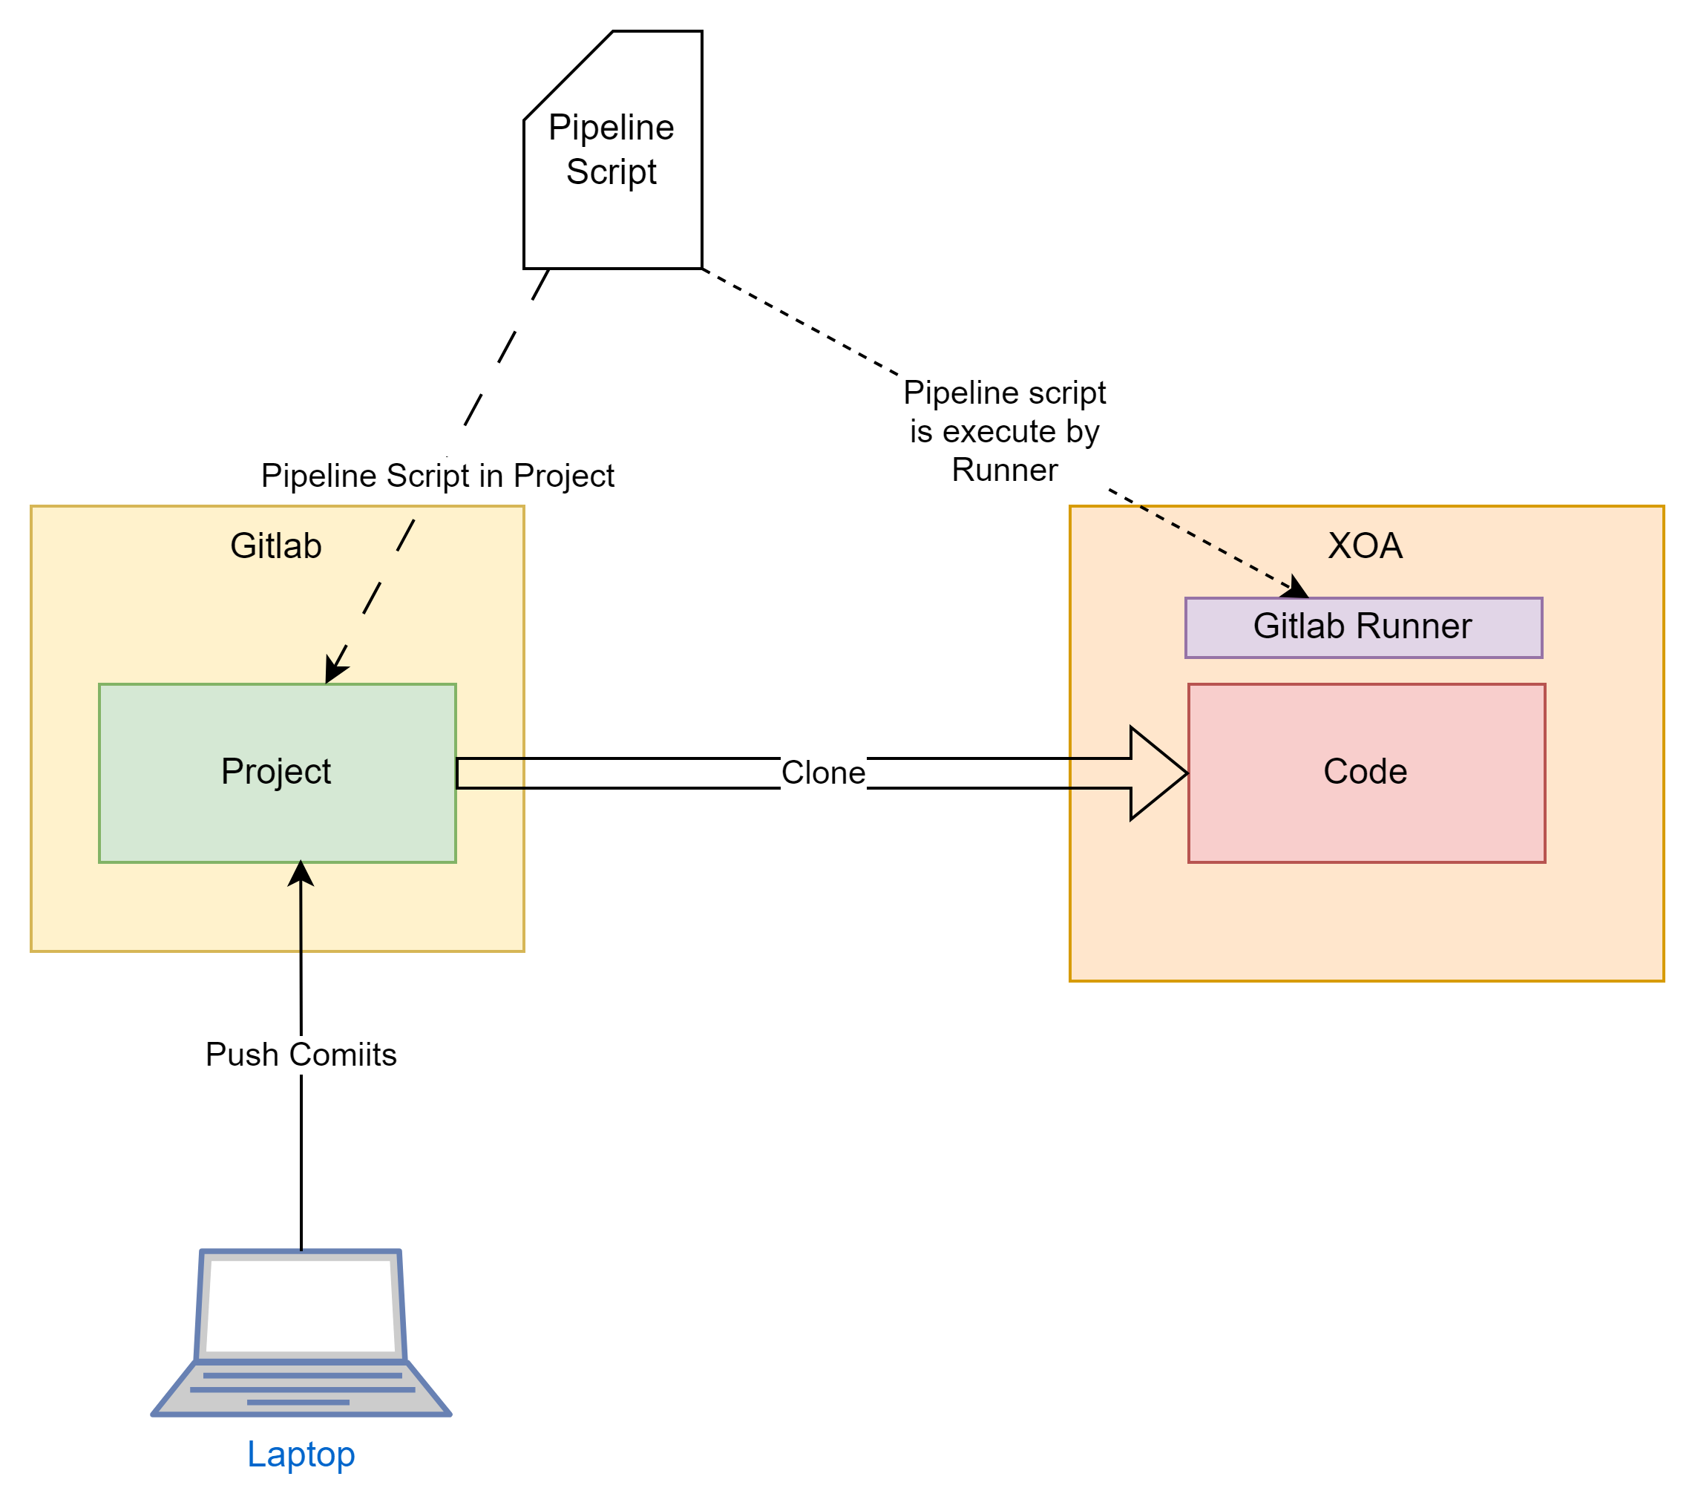
Pipeline Process
Developer pushes commits or merge requests.
If project has pipeline script:
  Code is cloned
  Pipeline script is executed by Runner
  Results are gathered in Gitlab

Slide 18
Pipeline Environment
The simplest way to execute the pipeline is to clone and perform the steps on the host runner environment (e.g XOA).
However, in more complex or larger projects we may wish to run several pipeline steps at the same time.
We will also need to be sure the environment has the correct libraries and patch versions.
For this reason it is common to execute the Gitlab runner inside a Docker container.

